Slide 1
Next Generation of Semantic Search
Nils Reimers Principal Scientist @ cohere.ai
www.nils-reimers.de

Slide 2
Cohere bring the next generation of powerful NLP to developers and businesses of all sizes
World-class NLP models
- Text Generation - Classification - Embeddings
Ability to adapt to your dataset
Pay-as-you-go API
Speed-Optimized

Slide 3
Neural Search – Why all the Hype?
Real example on (Simple) Wikipedia (170k documents)
Query: What is the capital of the United States?
Top-3 Hits
Lexical Search (BM25)
Capital punishment (the death penalty) has existed in the United States […]
Ohio is one of the 50 states in the United States. Its capital is Columbus. […]
Nevada is one of the United States' states. Its capital […]
Neural Search
Washington, D.C. […] is the capital of the United States. […]
A capital city (or capital town or just capital) is a city or town, […]
The United States Capitol is the building where the United States Congress meets […]

Slide 4
Neural Search – Why all the Hype?
TREC Robust 04
pre-trained transformers
Source: Yang et al. SIGIR 2019. Critically Examining the Neural Hype...

Slide 5
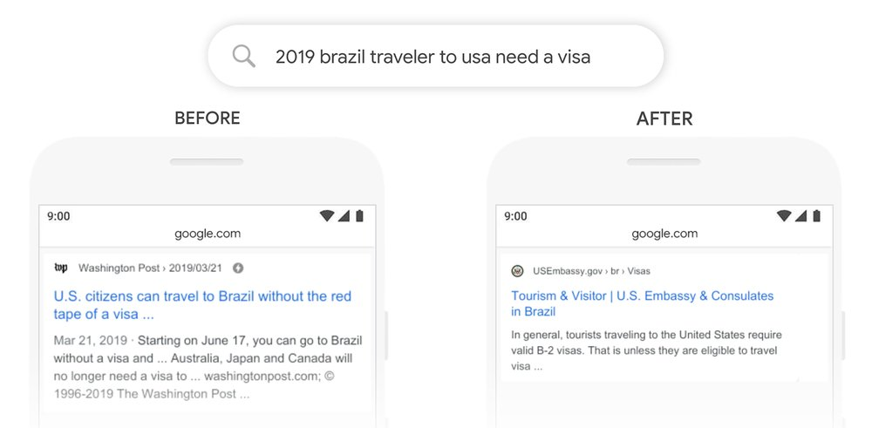
Search Quality Improvement in Industry
We’re making a significant improvement to how we understand queries, representing the biggest leap forward in the past five years, and one of the biggest leaps forward in the history of Search.
https://blog.google/products/search/search-language-understanding-bert/

Slide 6
Search Quality Improvement in Industry
Starting from April of this year (2019), we used large transformer models to deliver the largest quality improvements to our Bing customers in the past year.
https://azure.microsoft.com/en-us/blog/bing-delivers-its-largest-improvement-in-search-experience-using-azure-gpus/

Slide 7
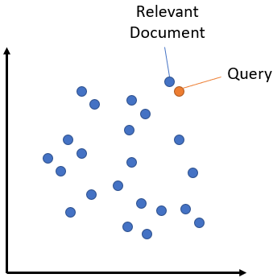
Bi-Encoders
Score
Cosine Similarity
vector
vector
pooling
pooling
BERT
BERT
Query
Document

Slide 8
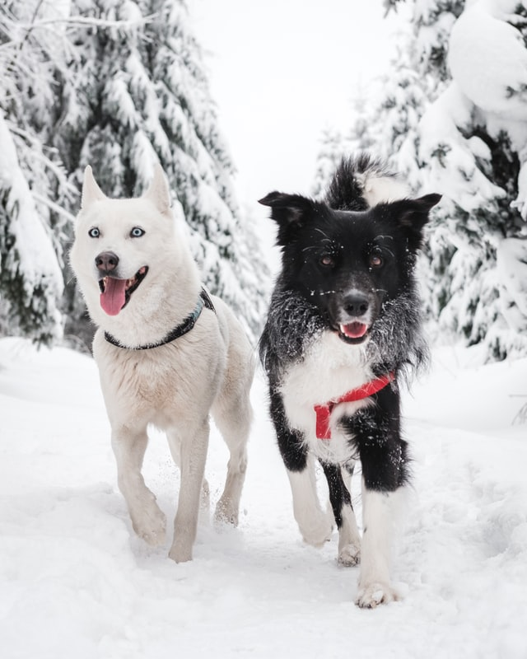
Multi-Modal & Multi-Lingual Search
A cat on a table
Image Embedding
Dos perros en la nieve
Text Embedding
Zwei Hunde im Schnee
两只狗在雪中
Two dogs in the snow
Two dogs in the snow
London at night

Slide 9
Dense Bi-Encoders
Can overcome the lexical gap
US vs USA vs United States
Respects the word order
Visa from Germany to Canada
Visa from Canada to Germany
Knows about related terms
“spearman correlation numpy” finds the entry: “spearman correlation SciPy”
pooling
BERT
Query
Img: https://www.pinecone.io/learn/dense-vector-embeddings-nlp/

Slide 10
Search in Large Vector Spaces

Slide 11
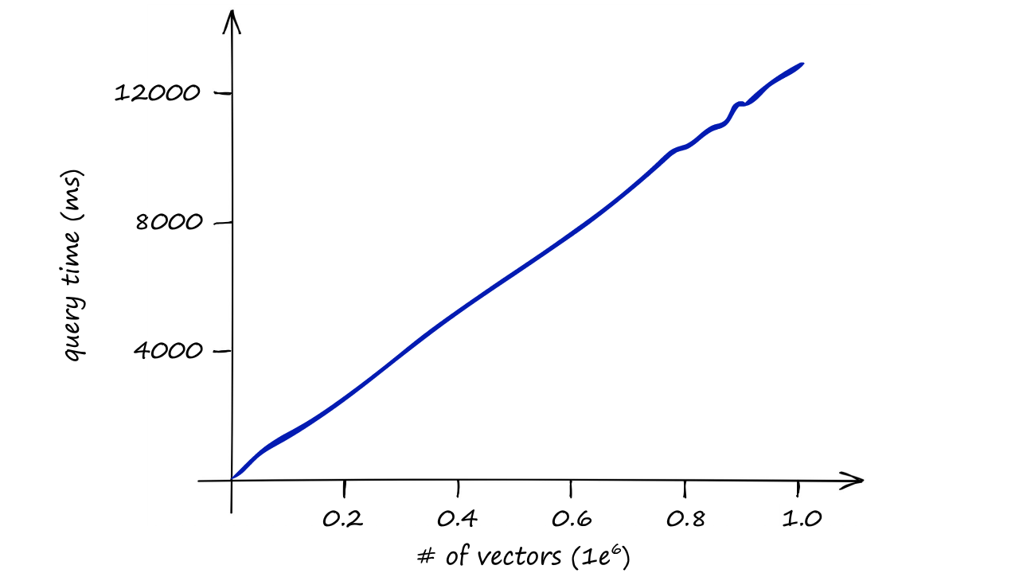
Option 1: Brute-Force
Only suitable for 10k – 100k vectors
https://www.pinecone.io/learn/faiss-tutorial/

Slide 12
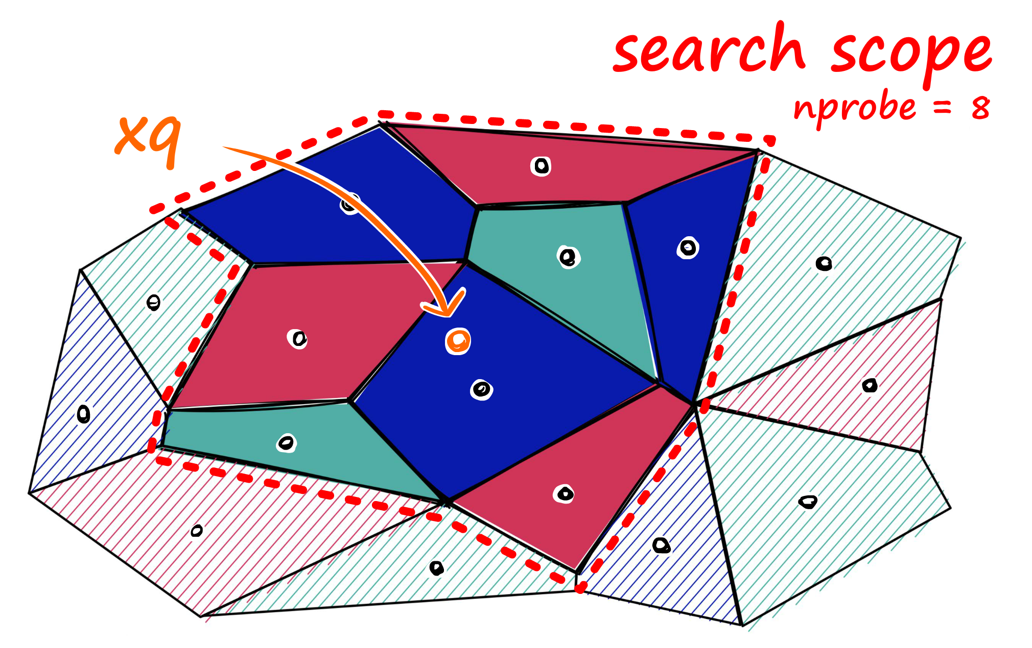
Option 2: IVF
query
K-means clustering
Search only in cells close to query
https://www.pinecone.io/learn/vector-indexes/

Slide 13
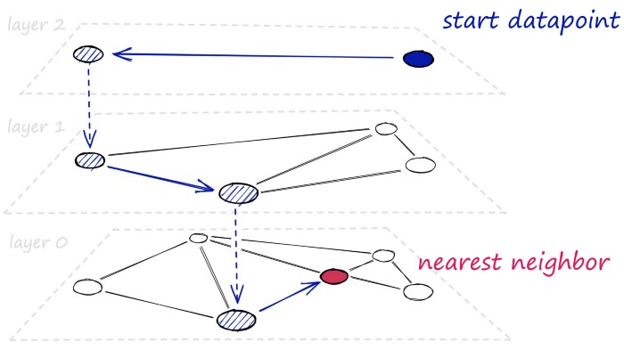
Option 3: HNSW
Hierarchical graph
Each layer stores connections to closest points
Top layer: sparse vectors, big jumps
https://www.pinecone.io/learn/vector-indexes/

Slide 14
How to Train Representation Models?

Slide 15
Multiple Negative Ranking Loss
Have positive pairs: (a₁, p₁) (a₂, p₂) (a₃, p₃)
Examples:
(query, answer-passage)
(question, duplicate_question)
(paper title, cited paper title)
(a_{i}, p_{i}) should be close in vector space
(a_{i}, p_{j}) should be distant in vector space (i != j)
Unlikely that e.g. two randomly selected questions are similar
Also called “training with in-batch negatives”, InfoNCE or NTXentLoss
p₃
a₁
p₄
p₅
p₁
p₂

Slide 16
Multiple Negative Ranking Loss Intuitive Explanation
a₁: How many people live in Berlin?
p₁: Around 3.5 million people live in Berlin
p₂: Washington DC is the capital of the US
p₃: The 2021 Olympics are held in Japan
Compute text embeddings & compute similarities:
sim(a₁, p₁) = 0.5
sim(a₁, p₂) = 0.3
sim(a₁, p₃) = 0.1
See it as classification task and use Cross-Entropy Loss:
Prediction: [0.5, 0.3, 0.1]
Gold: [ 1, 0, 0]

Slide 17
Shortcomings in Semantic Search

Slide 18
Fields of Issue
Keyword Search
Multiple Topics per text
Unknown Words / Domain Shift / Data Drift
Long Documents

Slide 19
Semantic Search is bad at… Keyword Search
Search for phone number, ISBN, specific error code, quote…
Solution:
Combine keyword & semantic search

Slide 20
Encoding Multiple Topics per Text
Bananas are the most sold fruit
Bananas are the most sold fruit. Facebook was founded by Mark Zuckerberg.
Facebook was founded by Mark Zuckerberg

Slide 21
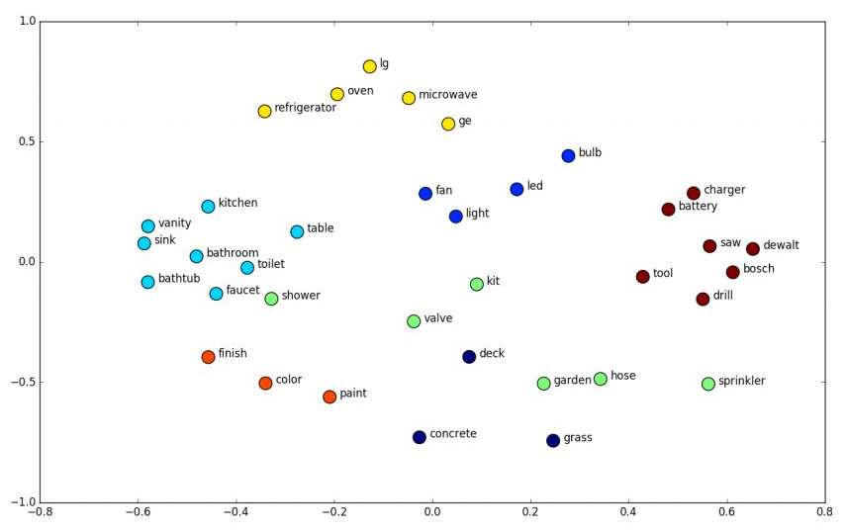
Encoding Multiple Topics – Avg. Embeddings
AVG(color, charger) = kit

Slide 22
Real Example
“Bananas are the most sold fruit. Facebook was founded by Mark Zuckerberg. My favorite game is Counter Strike. ”
Matching questions
0.55 “Who are Facebook's biggest competitors?”
0.46 “What is the best board game ever?”
0.45 “What are the best Asian snacks you can buy on Amazon?”
0.44 “Who founded Facebook”
Semantic search works best with 1 topic per text / vector

Slide 23
Challenge of Unknown Words for Dense Bi-Encoders
“BigBirdPegasus”
Dense Encoder
bigboss
bigdata
bigass
Img: https://www.shanelynn.ie/get-busy-with-word-embeddings-introduction/

Slide 24
Bi-Encoders and the Curse of the Unknowns
How do Bi-Encoders handle unknown words?
Not seen during pre-training
Not seen during fine-tuning
Where to put these words in a vector space?
BigBirdPegasus / Clexchain / Forwrd / 0xc004f213
Dense Bi-Encoders: Try to infer meaning from word form
Big challenge: Synonyms & related terms
Corona Virus ⬄ COVID-19 ⬄ SARS-Cov-2
Q: “Which vision transformer model is the best?” A: “ViT has been doing great in our experiments”
Notes:
Clexchain – Recent crypto coin
Forwrd - Company from Tel Aviv on automated predictive analytics
0xc004f213 – Windows error code, no product key was found

Slide 25
BEIR – Benchmarking IR
BEIR: A Heterogenous Benchmark for Zero-shot Evaluation of Information Retrieval Models, https://arxiv.org/abs/2104.08663

Slide 26
Bi-Encoders vs Lexical Search
Dataset | BM25 | Dense Model (TAS-B) | Difference
In-Domain | 22.8 | 40.8 | +18.0
BioASQ | 46.5 | 38.3 | -8.2
SCIDOCS | 15.9 | 14.9 | -1.0
BM25 was better on 10 / 18 datasets

Slide 27
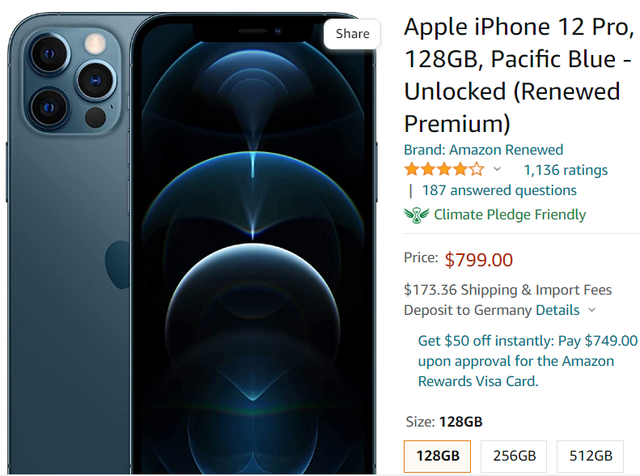
Transformers != Real Documents
BERT can only encode 512 word pieces (~300 words)
Some bi-encoders can only encode 128 word pieces

Slide 28
Next Generation of Semantic Search
Sparse Embeddings
Multi-Embedding Approaches
Hybrid Embeddings

Slide 29
Sparse Embeddings
Project BERT output to a sparse vector of BERT vocab size
“How to learn Python”
python:2.7, guide: 2.0, learn: 1.9, {:1.6, teach:1.5
Can add new (related) words (guide)
Some dimensions are hard to interpret ({)
No actual requirement that the 30k dims make sense
It is a bag-of-words - No word order
Flight London to Paris ⬄ Flight Paris to London
Projection
BERT
Query
Img: https://www.pinecone.io/learn/dense-vector-embeddings-nlp/

Slide 30
Multiple Topics Texts with Sparse Vectors
Bananas are the most sold fruit. => [banana: 1.8, bananas: 1.8, … ]
Facebook was founded by Mark Zuckerberg. => [facebook: 2.5, zuckerberg: 1.8, …]
My favorite game is Counter Strike. [game: 2.2, counter: 1.8, strike: 1.7, …]
“Bananas are […] Counter Strike”
=> [banana: 1.8, …, facebook: 2.5, …, game: 2.2, counter: 1.8, …]
No important information is lost
The original 3 vectors could mostly be re-constructed
Search for any of the 3 topics works well

Slide 31
Unknown Words for Sparse Bi-Encoders
“BigBirdPegasus”
Split query in word pieces:
big:2.1, ##bird: 2.0, ##pe: 1.8, ##gas: 2.0, ##us:1.9
Some related terms are added:
##birds: 1.2, giant: 0.7
Sparse models fallback to keyword search for unknown words
Sparse Encoder

Slide 32
Long Document Encoding – Sparse Vectors
Query: “Which university did Michelle Obama attend?”
Doc A: “Michelle Obama graduated from Princeton. She is married to Barack.”
Doc B: “Barack Obama graduated from Columbia. He is married to Michelle.”
Sparse vectors (SPLADE) are a bag-of-words approach
They don’t preserve the word order
Cannot tell if Doc A or Doc B is more relevant
The longer the doc => the more relevant the word order
“Barack Obama graduated from Columbia” vs. “Barack Obama [1k words] graduated [1k words] Columbia”

Slide 33
Long Document Encoding – Dense Vectors
Issues with encoding multiple topics
Compression problem:
512 dim vector
Each dim is float16
=> 1024 bytes
Compressing a doc with 100 pages to 1024 bytes is not possible

Slide 34
Multi-Vector Approaches
“Bananas are the most sold fruit. Facebook was founded by Mark Zuckerberg. My favorite game is Counter Strike. ”
Bananas
Favorite Game
Facebook

Slide 35
Long Document Encoding
Chunk data into paragraphs
Encode paragraphs individually
Perform retrieval on paragraph level => map back to document
Issue: Chunking text looses context information
“Barack Obama was born August 4th. […] He graduated from Columbia”

Slide 36
Hybrid Embeddings
Dense Embeddings
Topics
Word Order
Multiple topics
Unknown words
Sparse Embeddings
Multiple topics
Unknown Words
Word Order
Why not combine them?

Slide 37
Conclusion
Current Semantic Search works great when…
Test data similar to training data
Short documents (paragraphs)
Single discourse per text fragment
Cohere trains foundation models to search docs of…
Of any length
Multiple Fields
Any modality
Without labeled data

